Slide 1
Loading testing with aci
Jmeter performance testing

Slide 2
ABOUT ME
<name: Radhika Pather>
<Im a DevOps Specailist>
<My hobbies include hiking, swimming, F1 racing>
Twitter handle:

Slide 3
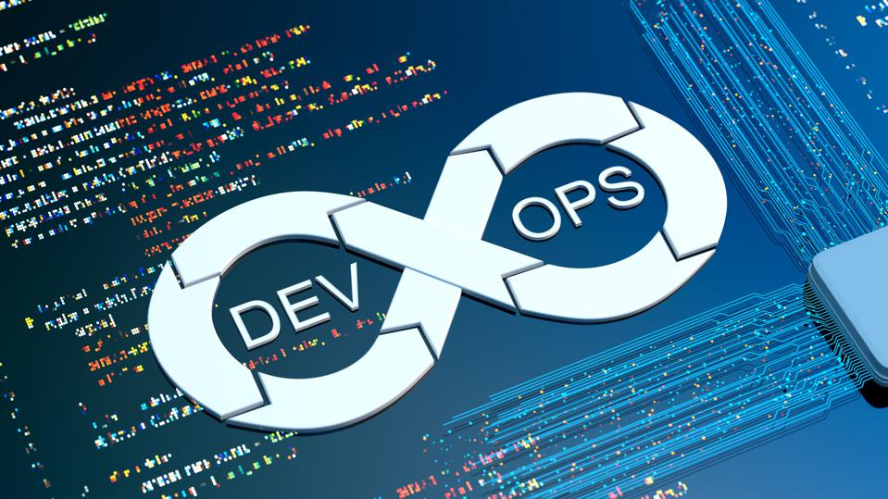
What is DevOps ?
Notes:
DevOps combines development and operations to increase the efficiency, speed, and security of software development and delivery compared to traditional processes. A more nimble software development lifecycle results in a competitive advantage for businesses and their customers.
DevOps can be best explained as people working together to conceive, build and deliver secure software at top speed. DevOps practices enable software development (dev) and operations (ops) teams to accelerate delivery through automation, collaboration, fast feedback, and iterative improvement.
Stemming from an Agile approach to software development, a DevOps process expands on the cross-functional approach of building and shipping applications in a faster and more iterative manner. In adopting a DevOps development process, you are making a decision to improve the flow and value delivery of your application by encouraging a more collaborative environment at all stages of the development cycle.
DevOps represents a change in mindset for IT culture. In building on top of Agile, lean practices, and systems theory, DevOps focuses on incremental development and rapid delivery of software. Success relies on the ability to create a culture of accountability, improved collaboration, empathy, and joint responsibility for business outcomes.

Slide 4
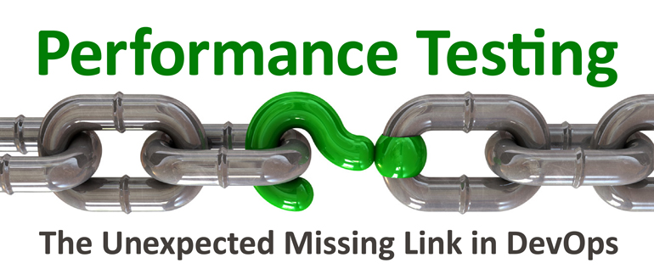
Do I, STILL CARE ????
Notes:
So does mean Performance Testing is excluded from testing the software no, it means it can be automated for part of the verification process for automated delivery of the software. Performance testing could save you a lot of money on infrastructure in the cloud, even though you have scaling infastructure, you still need to know how your application under test is performing, that where performance testing comes into play

Slide 5
REPO
Terraform
Docker
ACI
Azure Container Registry
Virtual Networks

Slide 6
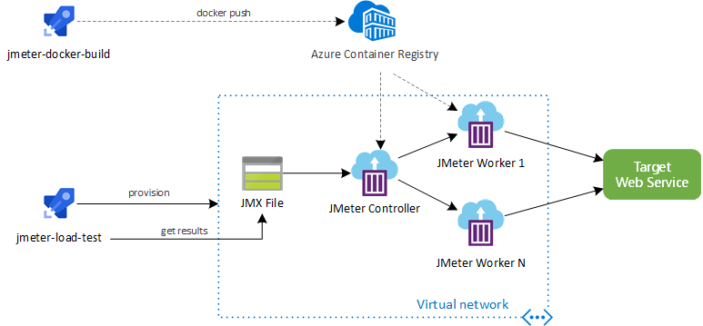
Architecture
Notes:
Using IaC (Infrastructure as Code) with create an environment to execute performance test, we two pipelines, one to create the docker container and add it to the acr and other to SETUP, TEST, RESULTS and TEARDOWN env

Slide 7
SETUP
Check if the JMeter Docker image exists
Validate the JMX file that contains the JMeter test definition
Upload JMeter JMX file to Azure Storage Account File Share
Provision the infrastructure with Terraform

Slide 8
tEST
Run JMeter test execution and wait for completion

Slide 9
result
Show JMeter logs
Get JMeter artifacts (e.g. logs, dashboard)
Convert JMeter tests result (JTL format) to JUnit format
Publish JUnit test results to Azure Pipelines
Publish JMeter artifacts to Azure Pipelines

Slide 10
TEARDOWN
Destroy all ephemeral infrastructure with Terraform

Slide 11
Terraform incudes
Resource Group
Virtual Network (VNet)
Storage Account File Share
1 JMeter controller on ACI
N JMeter workers on ACI

Slide 12
Demo

